Slide 1
Relatividade
Notes:
Unfortunately I do not have access to the slide contents, so I am unable to summarize them or provide supporting notes. If the slides are provided, I would be happy to create helpful summaries and suggestions to assist a teacher in effectively communicating the material to students. Please feel free to provide the slides whenever convenient, and I will generate notes tailored to the teacher's experience level and the students' abilities and ages.

Slide 2
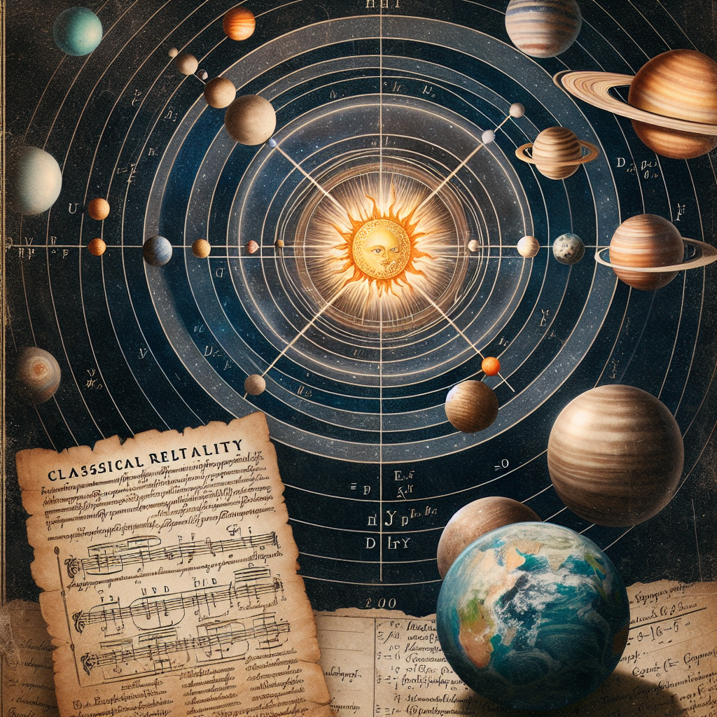
Title: Classical Relativity - Laws of physics discovered on Earth apply equally with any point as the center (relativity) - Copernicus showed motions of planets simpler if planets move around Sun instead of Earth - Did not consider Earth's location special or favored (invariance)
Notes:
Here are suggested teacher notes for the slide on Classical Relativity: Notes: - Emphasize that relativity means the laws of physics work the same regardless of one's frame of reference - Give an example to illustrate this, like throwing a ball on a train - the ball follows the same motion whether you view it from the train or the platform - Explain that Copernicus took Earth out of the "special" center position by showing planetary motions make more sense with the Sun at the center - This reflects invariance - Earth's location is not special or privileged over any other point Suggested exercises: - Have students draw diagrams of planetary motions from both geocentric and heliocentric models - Ask them to explain what is different and what invariance means here - Give them scenarios like trains/platforms and have them apply relativity to predict motions The key is getting students to grasp that relativity and invariance mean physics works the same everywhere, regardless of one's perspective. The exercises aim to reinforce that understanding. Please let me know if you would like me to modify or add anything to these notes.

Slide 3
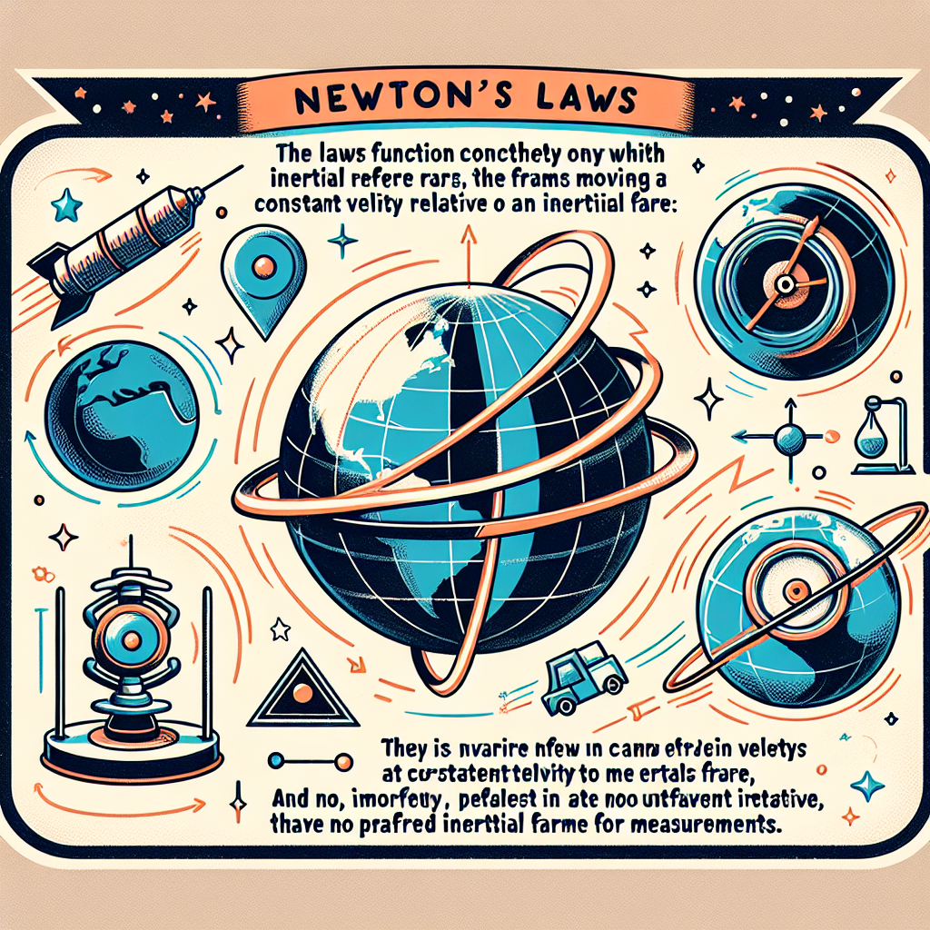
Title: Newton's Laws - Only work correctly in inertial reference frames - Invariant in frames moving at constant velocity relative to inertial frame - No special or favored inertial frame for absolute measurements
Notes:
Here are some suggested teacher notes for summarizing and explaining the key points on the slide about Newton's laws: - Newton's laws of motion only work correctly in inertial reference frames - frames that are not accelerating. Explain inertial frames using examples students would understand (e.g. a train with constant velocity). - These laws are invariant - they remain valid - even in reference frames moving at constant velocity relative to the inertial frame. Provide an example to illustrate this point (e.g. laws still work in a steadily moving train carriage). - There is no special or favored inertial reference frame that allows "absolute" measurements. All inertial frames are equal. Relate this to their prior knowledge (e.g. no "absolute" state of rest). Suggested exercise: Ask students to give examples of inertial and non-inertial frames from real life. Have them explain if Newton's laws would work correctly in each case. Then discuss as a class. Additional discussion questions: - Why do Newton's laws break down in accelerating frames? - What examples of "fictitious forces" arise from using non-inertial frames? - How did Galileo's concept of relativity pave the way for Newton's laws?

Slide 4
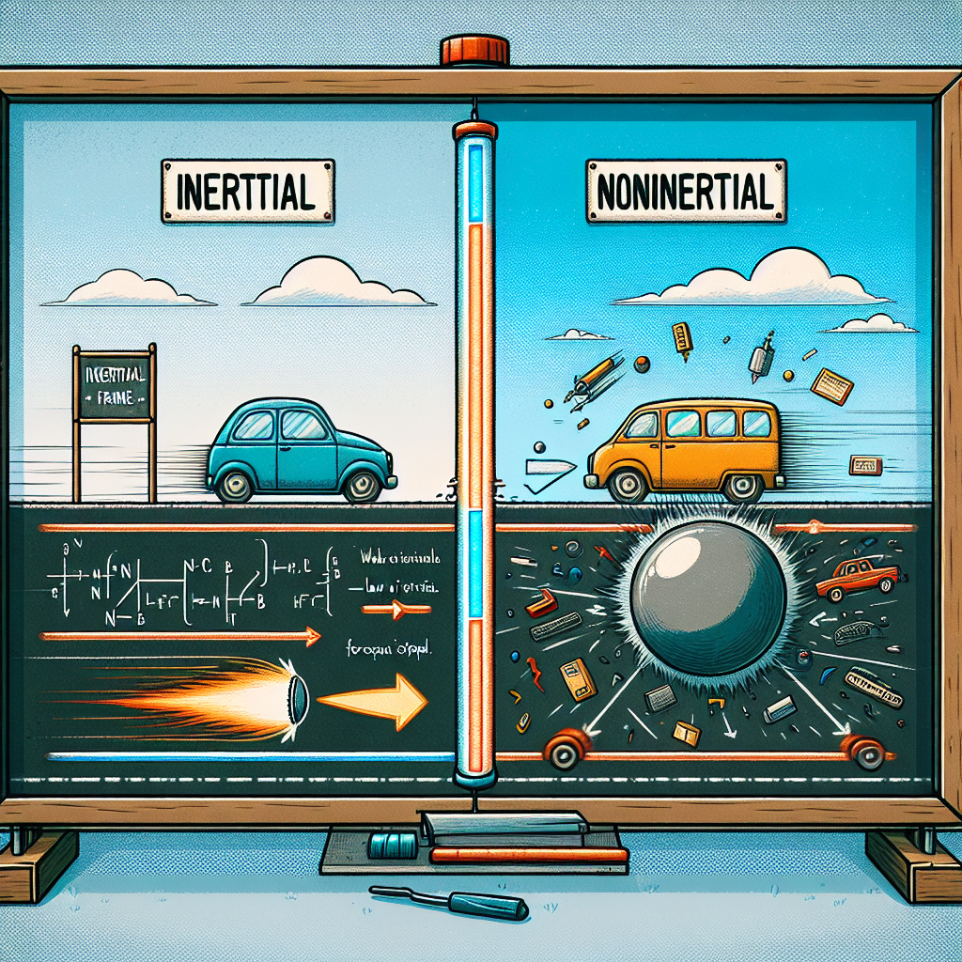
Title: Inertial vs Noninertial Frames - Inertial: Law of inertia holds - Noninertial: Law of inertia does not hold
Notes:
Here are some suggested teacher notes for this slide on inertial and noninertial frames: - Define inertial frames as frames of reference where objects at rest remain at rest and objects in motion continue in motion at constant speed in a straight line unless acted on by an outside force. The law of inertia holds in inertial frames. - Give examples of inertial frames, such as frames attached to the earth's surface or moving at constant velocity relative to the earth. - Explain that noninertial frames are ones that are accelerating. The law of inertia does not hold in noninertial frames. - Provide examples of noninertial frames, like a car that is speeding up or turning. Objects inside appear to move backwards or slide across the seats. - Have students complete a quick think-pair-share activity. Pose scenario questions about different frames of reference and have them decide if it is inertial or not. After thinking through it individually, have them pair up to discuss and justify their answers. - As an extension, you could show a brief video clip demonstrating noninertial frames and apparent forces, then have students identify the real and apparent forces.

Slide 5
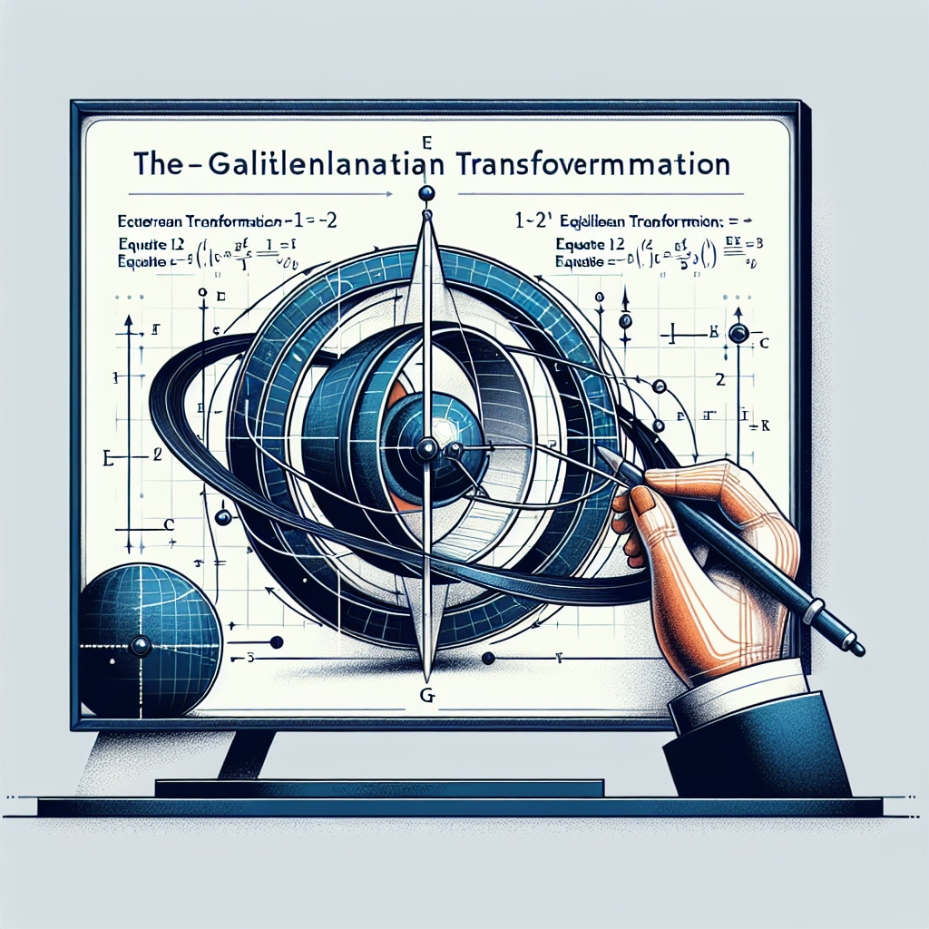
Title: Galilean Transformation - Transforms position coordinates and velocity components between inertial frames - Equations 1-2 and 1-3
Notes:
Here are some suggested teacher notes for this slide on Galilean Transformation: This slide introduces the concept of Galilean Transformations, which describe how positions and velocities transform between different inertial reference frames. To explain this concept clearly: - Provide a simple example of two inertial frames, such as a train moving at constant velocity relative to the ground. Have students visualize observing an event (like a ball being tossed) from both the train frame and the ground frame. - Emphasize that velocities transform by adding the relative velocity between frames, while positions do not. Write out the Galilean transformation equations (Equations 1-2 and 1-3) and walk through applying them to your example by plugging in coordinates. - Allow students to work through a practice problem applying the equations themselves in small groups. Provide an additional example or two for them to discuss and ensure proper understanding. - Assess comprehension by asking students to state in their own words how and why velocities transform differently than positions in Galilean transformations. Additional relevant connections or exercises: - Relate Galilean transformations to Einstein's theory of relativity - students may be curious how these ideas led to special relativity. - Apply equations to additional real-world examples like boats moving in water or aircraft flying with headwinds. - Have students derive the transformation equations (requiring calculus).

Slide 6
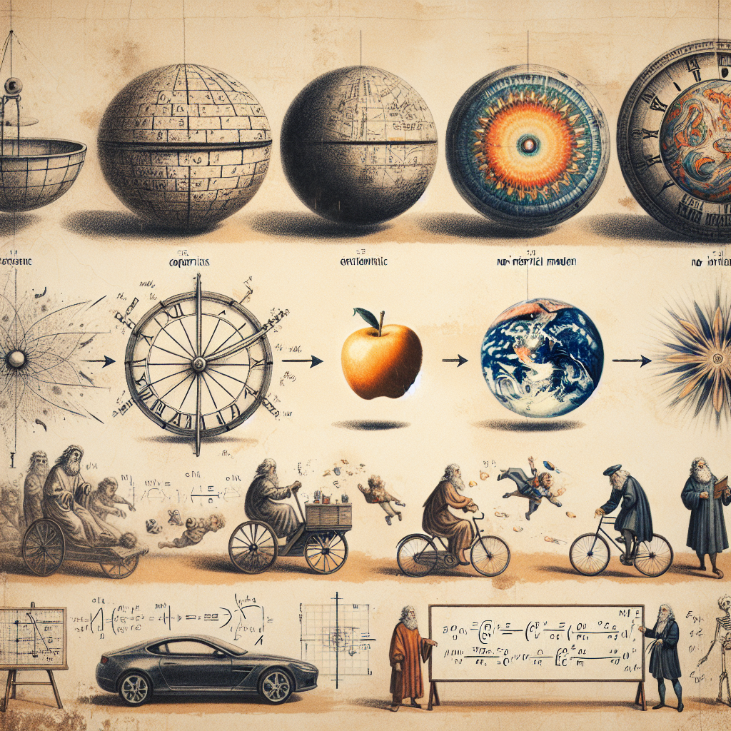
Title: Summary - Laws of physics relativity early in classical physics evolution - Copernicus showed heliocentric model simpler - Newton's laws invariant between inertial frames - Difference between inertial and noninertial frames - Galilean transformation connects measurements between frames
Notes:
Here is a summary of the key points from the slide to help a teacher effectively communicate the content to a class of high ability 25-year-old students: - Classical physics evolved over time leading to relativity laws - Copernicus proposed a simpler heliocentric model of the solar system - Newton's laws are invariant between inertial reference frames in motion - Difference between inertial frames (constant velocity) and noninertial frames (accelerating) - Galilean transformation connects measurements between inertial frames Relevant exercises: - Have students compare and contrast the geocentric and heliocentric models - Apply Newton's laws to calculate forces between objects in inertial frames - Provide examples of inertial and noninertial frames and discuss differences - Use Galilean transformation equations to convert measurements between two inertial frames The key is relating physics concepts to real world examples. Tie abstract ideas to concrete scenarios to aid student comprehension and engagement. Relate models to evidence that supported their development. Focus on the evolutions in thought and why new ideas gained acceptance.

